Slide 1
Peripherals Devices and Input-Output Interface
Input-output device attached to the computer are also called peripherals. Like monitor and Keyboard, printer, magnetic tape and Magnetic Disk etc.
Input-Output Interface:
Input-output interface provides a method for transferring information between internal storage and external I/0 devices.
Peripherals connected to a computer need special communication links for interfacing them with the central processing unit.
The purpose of the communication link is to resolve the differences that exist between the central computer and each peripheral. The major differences are:
1. Peripherals are electromechanical and electromagnetic devices and their manner of operation is different from the operation of the CPU and memory, which are electronic devices. Therefore, a conversion of signal values may be required.
2. The data transfer rate of peripherals is usually slower than the transfer rate of the CPU, and consequently, a synchronization mechanism may be needed.

Slide 2
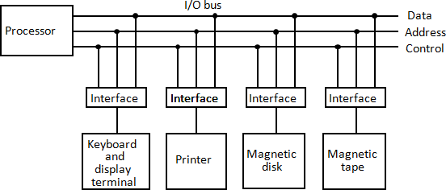
3. Data codes and formats in peripherals differ from the word format in the CPU and memory.
4. The operating modes of peripherals are different from each other and each must be controlled so as not to disturb the operation of other peripherals connected to the CPU
To resolve these differences, computer systems include special hardware components between the CPU and peripherals to supervise and synchronize all input and output transfers, are called interface.

Slide 3
The I/O bus consists of data lines, address lines, and control lines. The magnetic disk, printer, and terminal are employed in practically any general purpose computer.
Each peripheral device has associated with it an interface unit.
Each interface decodes the address and control received from the I/O bus, interprets them for the peripheral, and provides signals for the peripheral controller.
It also synchronizes the data flow and supervises the transfer between peripheral and processor.
Each peripheral has its own controller that operates the particular electromechanical device.
For example, the printer controller controls the paper motion, the print timing, and the selection of printing characters.

Slide 4
The I/O bus from the processor is attached to all peripheral interfaces.
To communicate with a particular device, the processor places a device address on the address lines.
Each interface attached to the I/O bus contains an address decoder that monitors the address lines.
When the interface detects its own address, it activates the path between the bus lines and the device that it controls.
All peripherals whose address does not correspond to the address in the bus are disabled by their interface
There are four types of commands that an interface may receive. They are classified as control, status, data output, and data input.

Slide 5
A Control Command is issued to activate the peripheral and to inform it what to do.
For example, a magnetic tape unit may be instructed to backspace the tape by one record, to rewind the tape, or to start the tape moving in the forward direction.
A Status Command is used to test various status conditions in the interface and the peripheral.
For example, the computer may wish to check the status of the peripheral before a transfer is initiated.
A Data Output Command causes the interface to respond by transferring data from the bus into one of its registers.
The computer starts the tape moving by issuing a control command. The processor then monitors the status of the tape by means of a status command. When the tape is in the correct position, the processor issues a data output command.
The interface responds to the address and command and transfers the information from the data lines in the bus to its buffer register.

Slide 6
The Data Input Command is the opposite of the data output.
In this case the interface receives an item of data from the peripheral and places it in its buffer register.
The processor checks if data are available by means of a status command and then issues a data input command. The interface places the data on the data lines, where they are accepted by the processor.

Slide 7
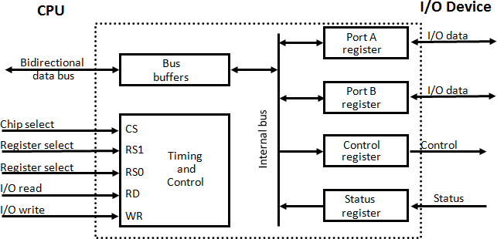
I/O interface with example
CS | RS1 | RS0 | Register Selected
0 | X | X | None: data bus in high impedance
1 | 0 | 0 | Port A register
1 | 0 | 1 | Port B register
1 | 1 | 0 | Control register
1 | 1 | 1 | Status register

Slide 8
It consists of two data registers called ports, a control register, a status register, bus buffers, and timing and control circuit.
The interface communicates with the CPU through the data bus.
The chip select and register select inputs determine the address assigned to the interface.
The I/O read and writes are two control lines that specify an input or output, respectively.
The four registers communicate directly with the I/O device attached to the interface.
The I/O data to and from the device can be transferred into either port A or port B.
If the interface is connected to a printer, it will only output data, and if it services a character reader, it will only input data.
A magnetic disk unit transfers data in both directions but not at the same time, so the interface can use bidirectional lines.
The control register receives control information from the CPU. By loading appropriate bits into the control register, the interface and the I/O device attached to it can be placed in a variety of operating modes

Slide 9
The bits in the status register are used for status conditions and for recording errors that may occur during the data transfer.
For example, a status bit may indicate that port A has received a new data item from the I/O device.
This circuit enables the chip select (CS) input when the interface is selected by the address bus.
The two register select inputs RS1 and RS0 are usually connected to the two least significant lines of the address bus.
These two inputs select one of the four registers in the interface as specified in the table accompanying the diagram.
The content of the selected register is transfer into the CPU via the data bus when the I/O read signal is enables.
The CPU transfers binary information into the selected register via the data bus when the I/O write input is enabled.

